Slide 1
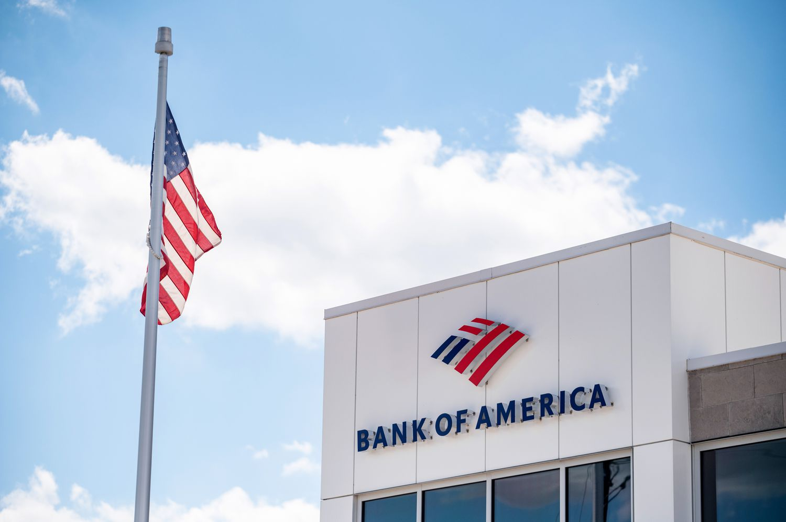

FINANCIAL CONSUMER COMPLAINTS ANALYSIS
BANK OF AMERICA (2017–2023)
PRESENTED BY: PARAG RAJENIMBALKAR

Slide 2

🧾 Problem Statement Bank of America receives a significant number of consumer complaints annually. These complaints cover a range of financial products and services and contain crucial information regarding customer dissatisfaction, complaint resolution, and service gaps. This analysis aims to uncover complaint trends, evaluate response effectiveness, and provide insights for improving customer service, regulatory compliance, and policy reforms.
🎯 Project Objectives
Analyze trends in complaints
Identify product & issue insights
Evaluate resolution types and timeliness
Uncover deeper issue-level patterns
Provide actionable insights for decision-makers

Slide 3

📊 Dataset Overview
The dataset consists of 62,516 consumer complaint records From 51 States filed against Bank of America from May 2017 to Aug 2023. Each record captures vital information about the nature of the complaint, associated product and issue, how the company responded, and whether the response was timely.
This dataset provides a rich source of insights into customer dissatisfaction, resolution patterns, and operational responsiveness, making it ideal for business and policy-level analysis
📌 Key Features of the Dataset
🗓️ Complaint Submission & Timeline
Complaint ID – Unique identifier for each consumer complaint
Date Submitted – Date on which the complaint was submitted by the consumer
Date Received – Date the Consumer Financial Protection Bureau (CFPB) officially received the complaint
👤 Customer & Product Information
Submitted Via – Channel through which the complaint was submitted (e.g., Web, Phone, Email)
State – U.S. state of the complainant
Product – The type of financial product involved (e.g., Credit Card, Mortgage, Bank Account)
Sub-Product – More specific product type under the main category
🚩 Complaint Details
Issue – General problem faced by the consumer (e.g., Billing Dispute, Account Management)
Sub-Issue – More detailed information about the main issue reported by the consumer.
💬 Company Response
Company Public Response – messages or statements made publicly by the company
Company Response to Consumer – Official resolution status (e.g., Closed with explanation, Relief provided)
⏱️ Resolution Timeliness
Timely Response – Indicates whether the company responded within the expected time (Yes/No)

Slide 4
SQL QUERIRS

Slide 5
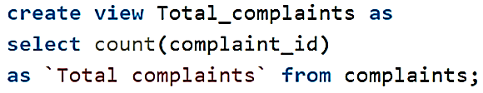
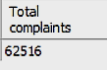
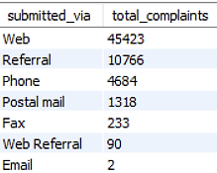
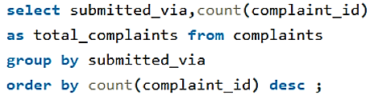
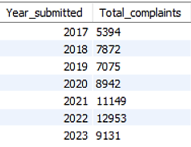
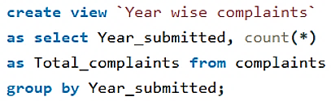
1. How many total complaints are in the dataset?
2)What are the complaint submission channels?
3)What is the trend of complaints year-wise?

Slide 6
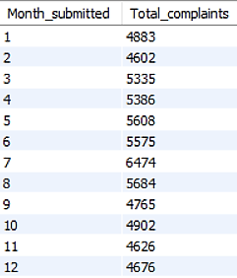
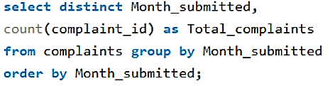
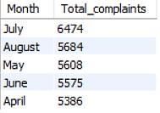
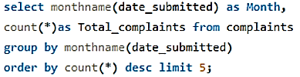
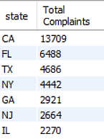
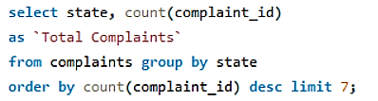
4) Month wise Complaints
5) In which months do complaints spike the most?
6) States with Most Complaints

Slide 7
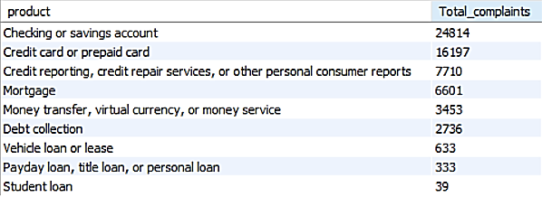
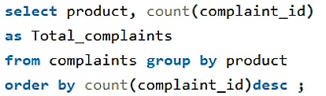
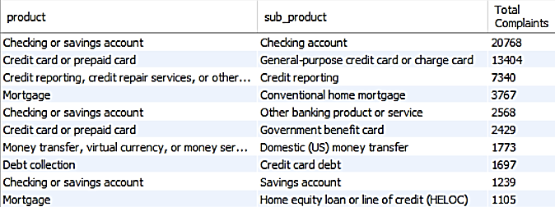
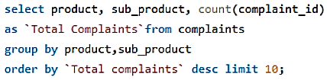
7) Product Wise Complaints
8) Sub-Products with Most Complaints

Slide 8
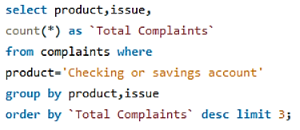
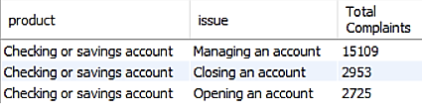
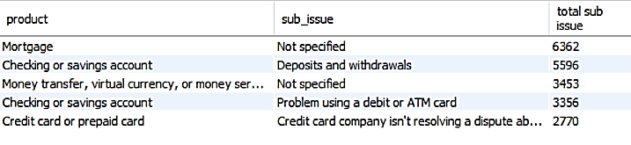
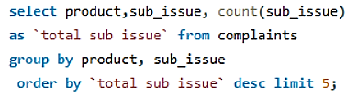
9) Top 3 Issues for Top Product
10) Top Sub-Issues for Product

Slide 9
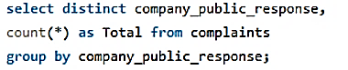
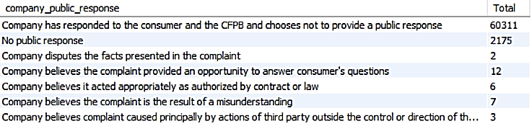
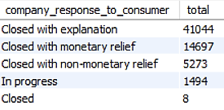
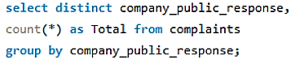
11) Public Company Responses
12) Complaint Resolution Types

Slide 10
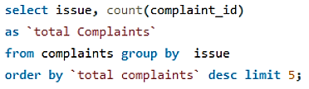
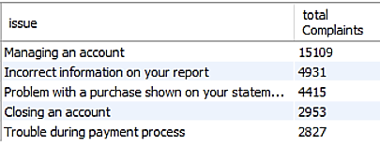
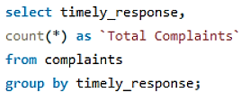
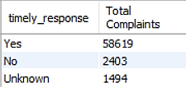
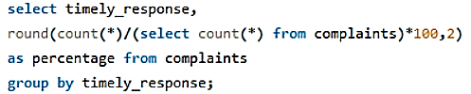
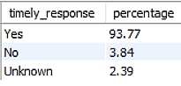
13) What are the most common complaint issues?
14) Timeliness of Responses
15) Timely response percentage

Slide 11

📊 Final Insights
Total Complaints: 62,516
Date Range: May 2017 → Aug 2023
🔹 Seasonal & Trends
Complaints steadily grew until ~2020, then stabilized.
Spikes in July & December are visible (seasonal stress points).
🔹 Products
Most complaints:
Checking/Savings Accounts → 24,814
Credit Cards/Prepaid Cards → 16,197
Credit Reporting/Repair → 7,710
Mortgage → 6,601
Money Transfer/Virtual Currency → 3,453
🔹 Issues
Top issues reported:
Managing an account → 15,109
Incorrect information on your report → 4,931
Problem with purchase on statement → 4,415
Closing an account → 2,953
Payment process troubles → 2,827
🔹 Channels
Majority via Web (45,423)
Referral = 10,766, Phone = 4,684.
Postal/Fax minimal.
🔹 States
Top 5: CA (13,709), FL (6,488), TX (4,686), NY (4,442), GA (2,921)
🔹 Company Responses
Closed with explanation → 41,044 (largest).
Closed with monetary relief → 14,697.
Closed with non‑monetary relief → 5,273.
In progress/Closed = minimal.
🔹 Public Responses
Most frequent: “Company has responded to the consumer and the CFPB and
chooses not to provide a public response” → 60,311.
Other responses extremely rare.
🔹 Timeliness
93.8% timely responses.
3.8% untimely
~2.4% unknown.
Untimely responses occur more in credit cards & loans.

Slide 12
🎯 Key Takeaways
Checking/Savings accounts = biggest driver of complaints
Web channel dominates → digital handling should remain focus.
California, Florida, Texas, NY, GA are hotspots.
Resolution quality is questionable → majority “Closed with explanation”, few with actual relief.
Most complaints lack a meaningful public response → transparency gap.
Timeliness is strong overall (~94%), but must improve for specific products like credit cards & loans.

Slide 13


